Slide 1
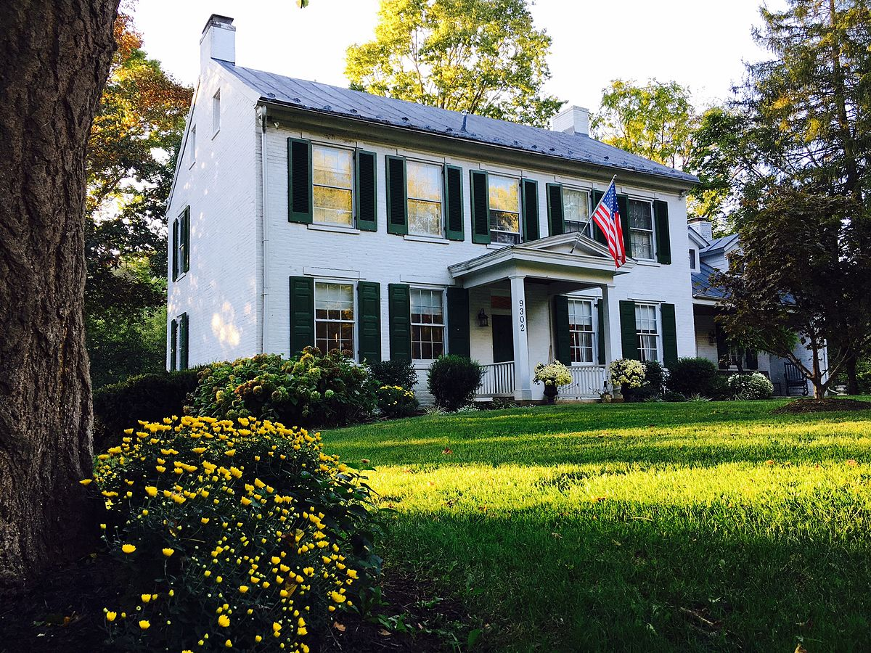
Investing in Real Estate: Ames, IA
Uncovering Undervalued Properties
to Maximize Profitability

Slide 2
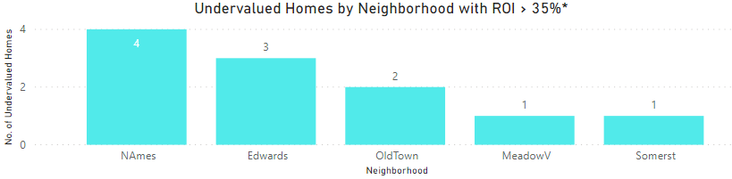
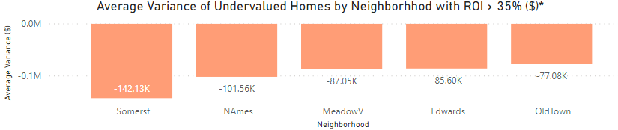
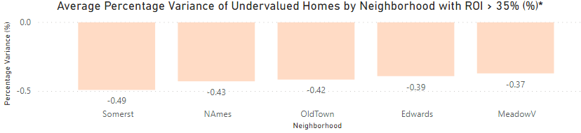
Homes with the most profit potential are undervalued. Top 6 deals: 1 home in Somerset with profit potential of $142K (49% ROI), 4 homes in North Ames worth $102K on average (43% ROI), 1 home in Meadow V. worth $87K (37% ROI), totaling $635K profit potential.
Average Home Valuation Only Shown for Undervalued Homes ($, %)
Key Insights
Eleven undervalued homes in Ames have an ROI > 35% worth $1M profit potential, which also includes:
3 homes in Edwards worth $85K on average (39% ROI)
2 homes in Old Town worth $77K on average (42% ROI)
* Results filtered for undervalued homes with factors typically associated with above-average valuations: garage capacity >= 2 cars, great living area >= 1,200 sq. ft., full baths >= 2, overall quality score 5-8, and total rooms above ground >= 7.
Source: https://www.kaggle.com/pmarcelino/comprehensive-data-exploration-with-python#Out-liars! (accessed 2/24/2020)

Slide 3
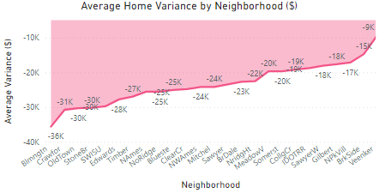
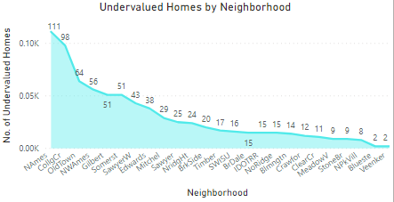
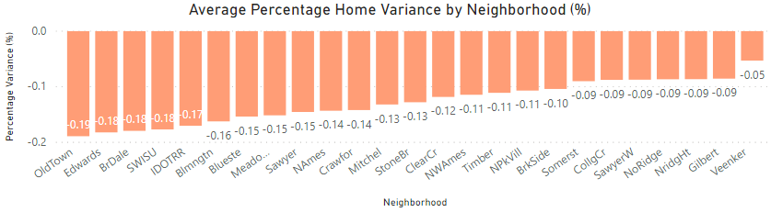
Across all neighborhoods, homes are undervalued by an average of $23,200 (13% ROI). Sixty-four homes in Old Town are currently $30K (19%) below market value, 14 homes in Bloomington are $36K (16%) below, and 12 in Crawford are $31K (14%) below.
Home Variance Only Shown for Undervalued Homes ($, %)
Key Insights
On average, profit potential increases by $1,758 for every percentage point a home is undervalued.
Investing in homes in Old Town represents $1.9M total profit potential, while homes in Bloomington represents $504K, and homes in Crawford represent $372K.
Due to the high no. of undervalued homes, North Ames and College Center are the largest undervalued neighborhoods (worth $2.8M and $1.9M, respectively).
Source: https://www.kaggle.com/pmarcelino/comprehensive-data-exploration-with-python#Out-liars! (accessed 2/24/2020)

Slide 4
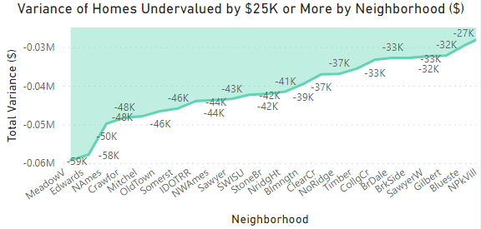
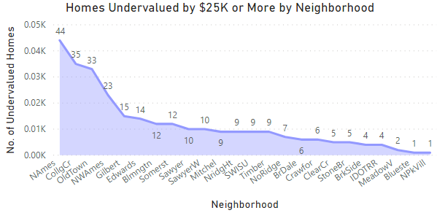
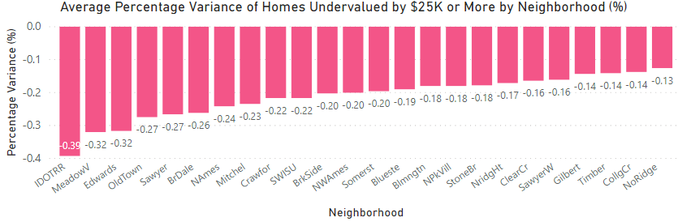
Homes undervalued by $25K+ represent an opportunity of $12.1M. On average, these homes are undervalued by $42K (21% ROI). Two homes in Meadow V. are $59K below market value (32% ROI) and 14 homes in Edwards are $58K below (32% ROI).
Only Shown for Undervalued Homes ($, %)
Key Insights
Forty-four homes in North Ames are $50K below market value (24% ROI).
In total, Ames has 285 homes undervalued by at least $25K (19.5% of all properties).
Investing in these homes in North Ames represents $2.2M total profit potential, while homes in Old Town represents $1.5M, and homes in College Center represent $1.2M.
Source: https://www.kaggle.com/pmarcelino/comprehensive-data-exploration-with-python#Out-liars! (accessed 2/24/2020)

Slide 5
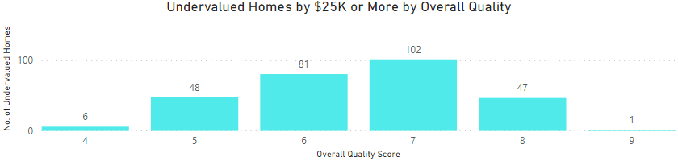
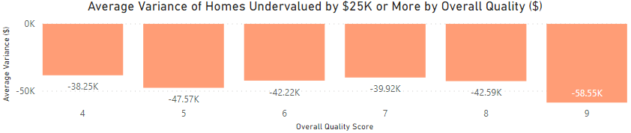
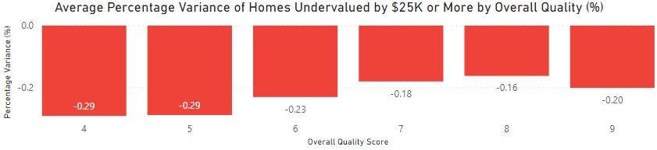
Most homes undervalued by $25K+ have an overall quality score of 6 (81 homes) or a score of 7 (102 homes). Forty-eight homes with a score of 5 are undervalued by $48K on average (29% ROI) and one home with a score of 9 is undervalued by $59K (20% ROI).
Home Variance Only Shown for Undervalued Homes ($, %)
Key Insights
Undervalued homes with overall quality scores of 6 and 7 represent the largest profit opportunities (worth $3.4M and $4.1M, respectively), due to the high no. of homes in these categories.
Investing in homes with an overall quality score of 4 represent $230K total profit potential, while homes with a score of 5 represent $2.3M, and homes with a score of 8 represent $2M.
Source: https://www.kaggle.com/pmarcelino/comprehensive-data-exploration-with-python#Out-liars! (accessed 2/24/2020)

Slide 6
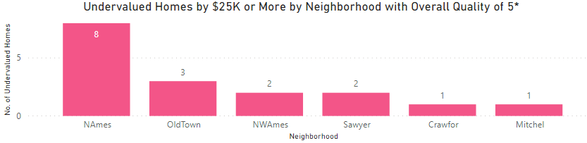
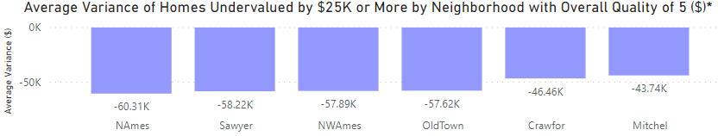
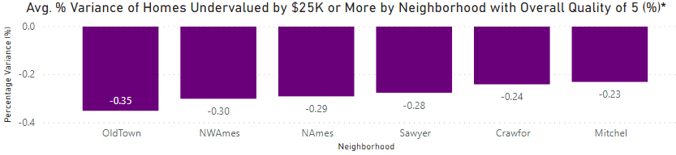
After screening for maximum profitability,* 17 homes with an overall quality score of 5 are below market value by at least $44K on average (23% ROI), including 8 homes in N. Ames that are undervalued by $60K (29%) and 2 in Sawyer undervalued by $58K (28%).
Home Variance Only Shown for Undervalued Homes ($, %)
Key Insights
Total profit potential for undervalued homes with an overall quality of 5 is $978K.
Homes in North Ames and Old Town represent the largest undervalued neighborhoods in this category (worth $480K and $170K, respectively), since 11 out of the 17 homes are located here.
* Results filtered for undervalued homes with factors typically associated with above-average valuations: garage capacity >= 2 cars, great living area >= 1,200 sq. ft., full baths >= 2, and total rooms above ground >= 7.
Source: https://www.kaggle.com/pmarcelino/comprehensive-data-exploration-with-python#Out-liars! (accessed 2/24/2020)

Slide 7
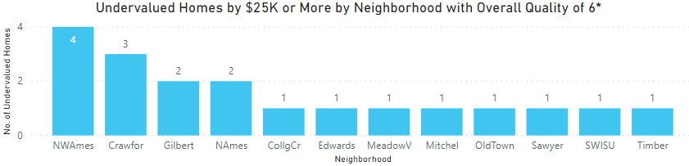
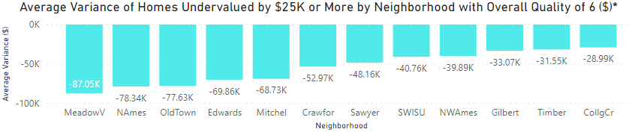
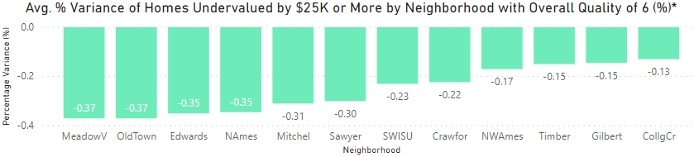
After screening for maximum profitability,* 19 homes with an overall quality score of 6 are below market value by at least $29K on average (13% ROI), including 1 home in Meadow V. undervalued by $87K (37%) and 2 in North Ames undervalued by $78K (35%).
Home Variance Only Shown for Undervalued Homes ($, %)
Key Insights
Total profit potential for undervalued homes with an overall quality of 6 is $994K.
Homes in Crawford, North Ames, and NW Ames represent the largest undervalued neighborhoods in this category (worth $160K apiece), since 9 out of the 19 homes are located here.
* Results filtered for undervalued homes with factors typically associated with above-average valuations: garage capacity >= 2 cars, great living area >= 1,200 sq. ft., full baths >= 2, and total rooms above ground >= 7.
Source: https://www.kaggle.com/pmarcelino/comprehensive-data-exploration-with-python#Out-liars! (accessed 2/24/2020)

Slide 8
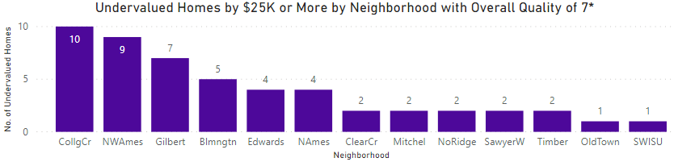
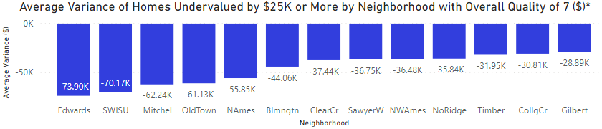
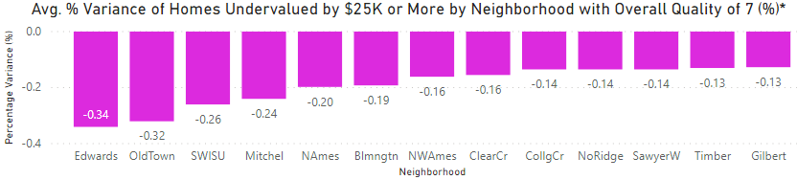
After screening for maximum profitability,* 51 homes with an overall quality score of 7 are undervalued by at least $29K on average (13% ROI), including 4 homes in Edwards that are $74K (34%) below market value and 2 homes in Mitchel that are $62K (24%) below.
Home Variance Only Shown for Undervalued Homes ($, %)
Key Insights
Total profit potential for undervalued homes with an overall quality of 7 is $2.1M.
Homes in NW Ames, College Center, and Edwards represent the largest undervalued neighborhoods in this category (worth $330K, 310K, and $300K, respectively), since 25 out of the 51 homes are located here.
* Results filtered for undervalued homes with factors typically associated with above-average valuations: garage capacity >= 2 cars, great living area >= 1,200 sq. ft., full baths >= 2, and total rooms above ground >= 7.
Source: https://www.kaggle.com/pmarcelino/comprehensive-data-exploration-with-python#Out-liars! (accessed 2/24/2020)

Slide 9
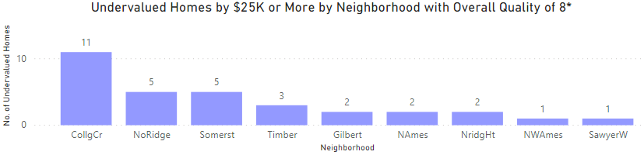
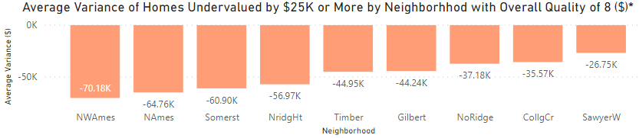
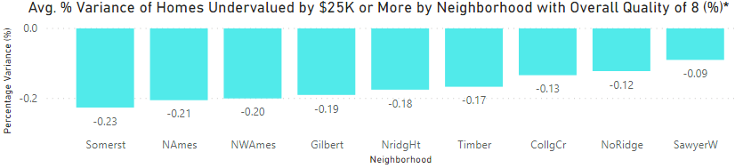
After screening for maximum profitability,* 32 homes with an overall quality score of 8 are undervalued by at least $27K on average (9% ROI), including 1 home in NW Ames that is $70K (20%) below market value and 2 in North Ames that are $65K (21%) below.
Home Variance Only Shown for Undervalued Homes ($, %)
Key Insights
Total profit potential for undervalued homes with an overall quality of 8 is $1.4M.
Homes in College Center, Somerset, and North Ridge, represent the largest undervalued neighborhoods in this category (worth $390K, 300K, and $190K, respectively), since 21 out of the 32 homes are located here.
* Results filtered for undervalued homes with factors typically associated with above-average valuations: garage capacity >= 2 cars, great living area >= 1,200 sq. ft., full baths >= 2, and total rooms above ground >= 7.
Source: https://www.kaggle.com/pmarcelino/comprehensive-data-exploration-with-python#Out-liars! (accessed 2/24/2020)

Slide 10
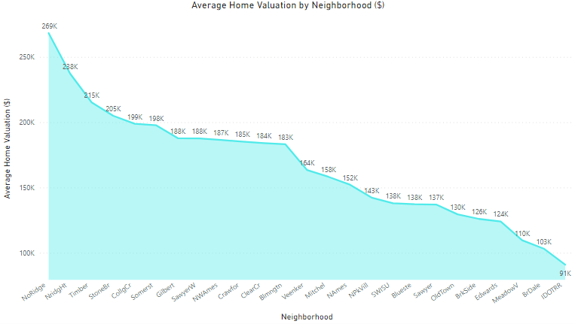
Seven key factors linked to above-average valuation were identified, then used to determine market value and find undervalued homes: overall quality score, great living area, basement size, rooms above ground, garage capacity, full baths, and year built.
Average Home Valuation Only Shown for Undervalued Homes ($)
Key Insights
Data were reviewed for 1,460 properties in 25 neighborhoods in Ames, IA.
Ames is located 30 miles north of Des Moines with a population > 65K, including > 35K students at Iowa State University.
Average price of an undervalued home is $170K (with a mean valuation of $167K).
In 2015, Bloomberg Business ranked Ames as one of “15 Cites That Have Done the Best Since the Recession” and one of the top 25 “Best Places for STEM Grads.”
Ames has > 750 undervalued homes (51% of total properties) across all neighborhoods.
Sources: https://www.cityofames.org/about-ames/about-ames (accessed 3/2/2020),
https://www.kaggle.com/pmarcelino/comprehensive-data-exploration-with-python#Out-liars! (accessed 2/24/2020)

Slide 11
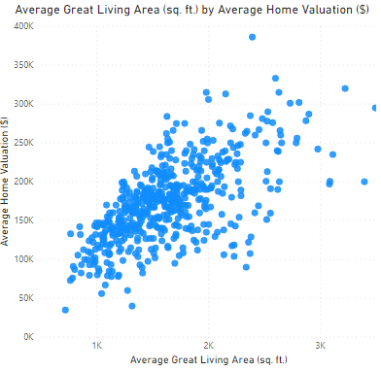
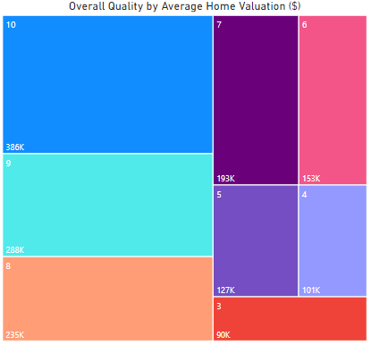
Homes with above average valuation have a great living area starting around 1,200 sq. ft. (accounting for 71% of all homes), and an overall quality score > 6 (43% of all homes). Strategic home improvements should also be considered in advance to boost valuation.
Average Home Valuation Only Shown for Undervalued Homes ($)
Key Insights
Average great living area is 1,580 sq. ft. Enlarging it by 434 sq. ft., increases average valuation by $22,320.
Average score for overall quality is 6.3. As the score goes up by 1.1 points, average valuation increases by $17,500.
Homes with an overall quality score of 7 are valued 14% above average, while those with a score of 10 are valued 178% above average.
Source: https://www.kaggle.com/pmarcelino/comprehensive-data-exploration-with-python#Out-liars! (accessed 2/24/2020)

Slide 12
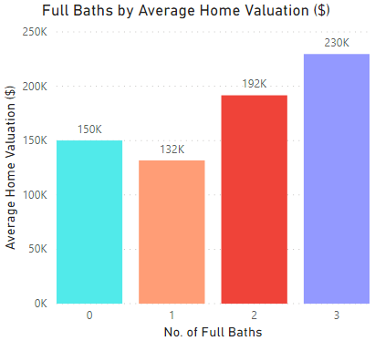
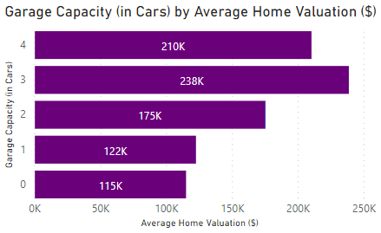
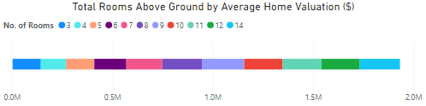
Homes with above average valuation have at least 2 full baths (accounting for 63% of all homes, only 1% have > 2), garage capacity for at least 2 cars, (68% of all homes, only 11% have > 2-car capacity), and at least 7 rooms above ground (88% of all homes).
Average Home Valuation Only Shown for Undervalued Homes ($)
Key Insights
Average no. of full baths is 1.6. For each bathroom added, average valuation increases by $49,000.
Average garage capacity is 1.9 cars. As capacity increases by 1.3, average valuation increases by $12,640.
Homes with a garage capacity of 3 cars are valued 40% above average, while homes with 4-car capacity have a valuation 24% above average.
Average no. of rooms above ground is 6.7. Homes with 7 rooms have an average valuation of $179,321 (5.5% above average), while homes with 10 have an average valuation of $190,607 (12% above average).
Source: https://www.kaggle.com/pmarcelino/comprehensive-data-exploration-with-python#Out-liars! (accessed 2/24/2020)

